Slide 1

Agent Skill Pipeline Overview
For Solo Elderly

Slide 2
Scenario & Goal
Target: Elderly, living alone, no family support
Devices: Smartwatch (GPS, vitals, fall detection)
Check-in: Every 3 days (voice)
Goal — Act as the primary safety net. Use telemetry + conversation + memory to:
Detect risk (falls, very high BP, isolation, sedentary, low mood)
Trigger emergency workflows when needed
Guide daily adherence: mobility, mental health, nutrition

Slide 3
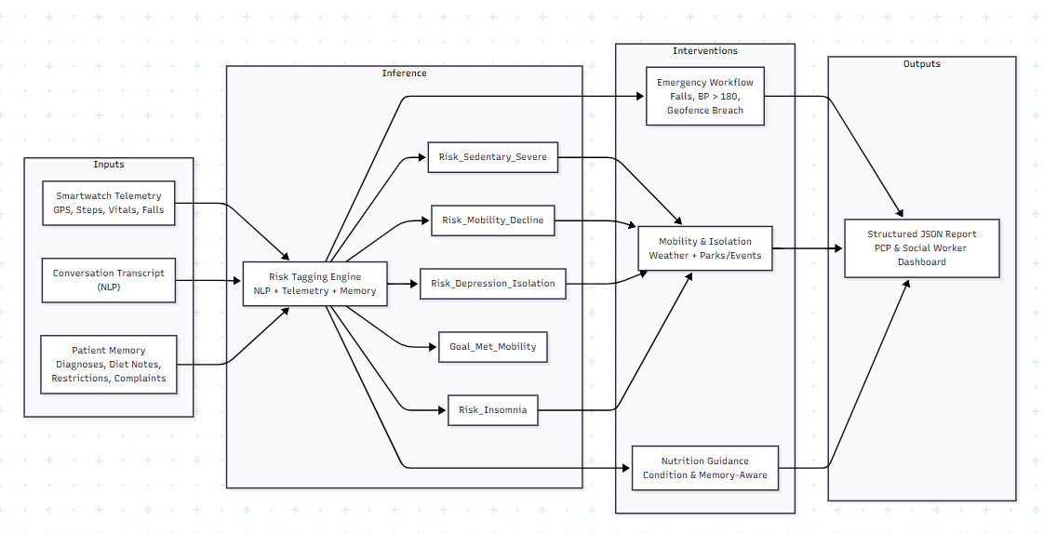
END-TO-END PIPELINE

Slide 4
Artifacts
solo_elderly_skill.md
Scenario + orchestration: persona, pre-call (Memory + Device API), emergency protocol, adherence flow, JSON report schema
references/ref_adherence.md
Risk rules + interventions: check-in objectives, NLP+telemetry → risk tags, MCP triggers (weather, parks, events), nutrition from memory, reporting fields

Slide 5
INTERVENTIONS & TOOLS
Emergency (from skill):
Systolic BP > 180, hard fall, geofence breach → get GPS → one yes/no prompt → dispatch_emergency_services(lat, lon), find_nearby_ER(lat, lon), alert PCP + case worker.
Mobility & isolation (from ref_adherence):
If Risk_Sedentary_Severe or Risk_Depression_Isolation → get_weather(lat, lon).
If safe: find_accessible_parks / find_community_senior_events. If not: indoor option (e.g. chair yoga).
Nutrition (memory-driven):
Use memory (diagnoses, diet notes, restrictions) → condition-based suggestions (e.g. low sodium for hypertension, small nutrient-dense meals for poor appetite). Never override clinician instructions in memory.

Slide 6
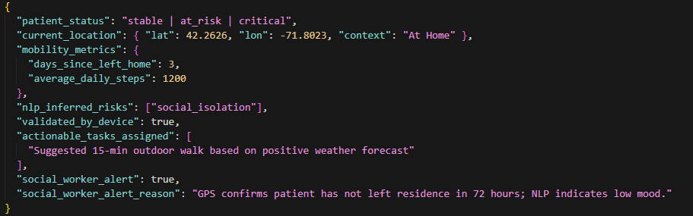
REPORTING
Every check-in produces a structured JSON, e.g.:
patient_status: stable | at_risk | critical
current_location (lat/lon + context)
mobility_metrics: days_since_left_home, average_daily_steps
nlp_inferred_risks, new_risk_tags_generated
actionable_tasks_assigned
social_worker_alert + reason

